Slide 1
Setting SEO Goals and Objectives
Businesses can earn significant revenues by leveraging the quality and relevance of this traffic for direct sales, customer acquisition, and branding/awareness campaigns
Visibility in search engines creates an implied endorsement effect, where searchers associate quality, relevance, and trustworthiness with sites that rank highly for their queries

Slide 2
Setting SEO Goals and Objectives
Consumers are increasingly turning to the Web before making purchases in verticals such as real estate, autos, furniture, and technology. Organizations cannot afford to ignore their customers’ needs as expressed through searches conducted on Google, Yahoo!, and Bing.

Slide 3
Setting SEO Goals and Objectives
Search engine optimization is a marketing function, and it needs to be treated like one. SEO practitioners need to understand the services, products, overall business strategy, competitive landscape, branding, future site development, and related business components just as much as members of other marketing divisions, whether online or offline

Slide 4
Setting SEO Goals and Objectives
When we do marketing, It is necessary to set the goal because without goal no marketing will get success

Slide 5
Strategic Goals SEO Practitioners Can Fulfill
Visibility (branding)
The SEO should work toward improving the search engine rankings for the website he / she is working on.
A website pages which are consistently at the top of search engine ranking get traffic, popularity and profit. There may be certain terms that are closely related to your brand that you want to dominate in the search rankings.

Slide 6
Continue….
For your brand visibility to be very high, it must have the following attributes:
It is distinctive and unique.
It serves an important niche and provides clear solutions.
The product is original and much better than the competition.
It is widely available for customers and has maximum points of sale.
It helps your business achieve its financial goals.

Slide 7
Strategic Goals SEO Practitioners Can Fulfill
Website traffic
To increase the website traffic SEO professional has to perform keyword research.
For example, when searching for a set of golf clubs, it may be that some users will type in lefthanded golf clubs as a search query.

Slide 8
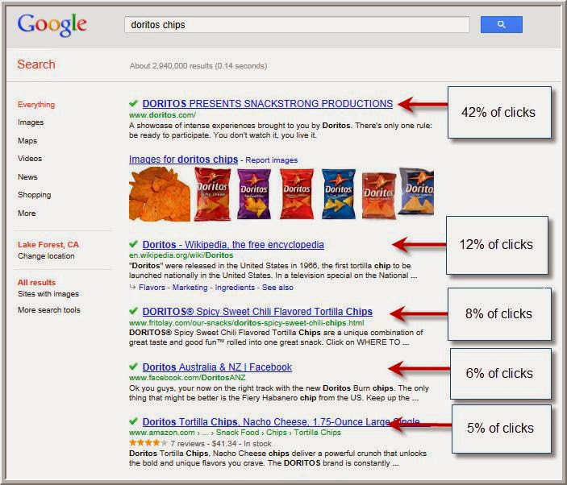
Continue…

Slide 9
Strategic Goals SEO Practitioners Can Fulfill
High ROI
An important component of SEO is to deliver not just traffic, but relevant traffic that has the possibility of converting.
For many organizations, SEO brings a higher ROI when compared to TV, print, and radio.
Data released by SEMPO in early 2009 shows that organic SEO is considered one of the very highest ROI activities for businesses given in below graph.

Slide 10
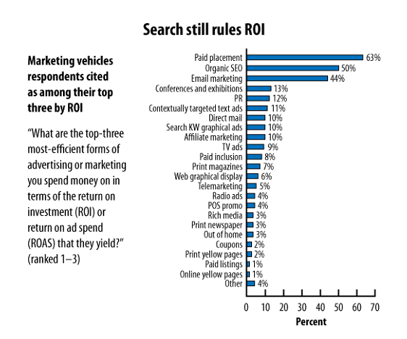
Strategic Goals SEO Practitioners Can Fulfill

Slide 11
Strategic Goals SEO Practitioners Can Fulfill
Every SEO Plan Is Custom
Organizations should take many factors into account when pursuing an SEO strategy, which includes:
* What the organization is trying to promote
* Target market
* Brand
* Website Structure
* Current Site Content

Slide 12
Strategic Goals SEO Practitioners Can Fulfill
Every SEO Plan Is Custom
* Ease with which the content and site structure can be modified
* Any immediately available content
* Available resources for developing new content
* Ccompetitive landscape

Slide 13
Strategic Goals SEO Practitioners Can Fulfil
Every SEO Plan Is Custom
For example, if one of the two competitors put its website up four years ago and the other company is just rolling one out now, the second company may need to focus on specific vertical areas where the first company’s website offering is weak.

Slide 14
Developing an SEO Plan Prior to Site Development
SEO plans have many moving parts, and SEO decisions can have a significant impact on other departments such as development, other marketing groups, and sales. Getting that input as soon as possible will bring the best results for a business at the least possible cost.

Slide 15
Business Factors That Affect the SEO Plan
Revenue/business model
It makes a difference to the SEO practitioner if the purpose of the site is to sell products, sell advertising, or obtain leads.
Target Customers
Who are you trying to reach? This could be an age group, a gender group, or as specific as people looking to buy a house within a 25-mile radius of Mumbai.

Slide 16
Business Factors That Affect the SEO Plan
Competitor strategies
The competitive landscape is another big factor in your SEO plan. Competition may be strongly entrenched in one portion of the market online, and it may make sense to focus on a different segment.
Branding goals
There may be terms that are critical for you to own for branding reasons.

Slide 17
Business Factors That Affect the SEO Plan
Budget for content development
An important part of link building is the quality of your content.
How your potential customers search for products like yours
Understanding what customers do when they are searching for products or services like yours is one of the most basic functions of SEO.

Slide 18
Understanding the Audience
Mapping your products and services
What types of products, services, and types of information and resources does your organization have to offer
SEO also should consider business development and the company’s expansion strategy at the outset of the SEO planning process.
Example of amazon.com i.e. from books to multi-product e-commerce portal.

Slide 19
Understanding the Audience
Content is the King
The content you have available to you will affect your keyword research and site architecture, as your site content is the major source of information that search engines use to determine what your site is about.
When looking at content plans it is critical to consider not only what you already have, but also what you could develop.

Slide 20
Understanding the Audience
Segmenting Your Site’s Audience
Audience is the most important factor in planning for SEO.
For example, Site A may be a website that sells gadgets. As a result, the site’s developers go out and implement a brilliant campaign to rank for the terms they consider relevant. Being young and energetic, they focus on the way their peers search for gadgets, but Site A is focused on selling gadgets to people who are age 50 or older.

Slide 21
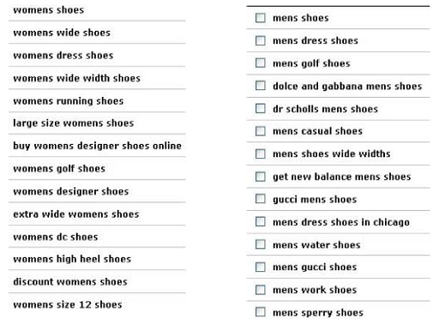
Understanding the Audience
Gender wise search terms used for shoes

Slide 22
Understanding the Audience
Location of Searcher
Another major criterion to consider might be location. Searchers in Rajkot, Gujarat may naturally want a different version of your product than searchers in Chicago.

Slide 23
Advanced Methods for Planning and Evaluation
SWOT Analysis
Sometimes you need to get back to the basics and carry out a simple overview strategy of where you are in the marketplace, and where you would like to be. A simple SWOT analysis is a great starting point. It creates a grid from which to work and is very simple to execute.

Slide 24
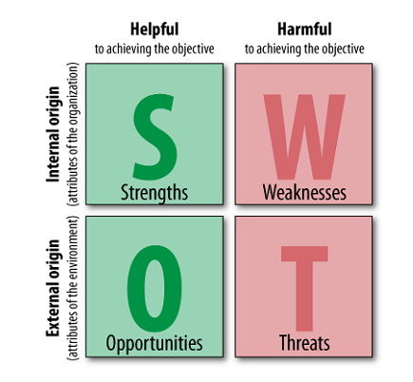
Advanced Methods for Planning and Evaluation

Slide 25
Advanced Methods for Planning and Evaluation
Get Smart
Every company is unique, so naturally their challenges are unique. Even a second SEO initiative within the same company is not the same as the first initiative. Your initial SEO efforts have changed things, creating new benchmarks, new expectations, and different objectives. These all make each SEO project a new endeavour.

Slide 26
SEO for Raw Traffic
Optimizing a site for search engines and creating keyword-targeted content helps a site rank for key search terms, which typically leads to direct traffic and referring links as more and more people find, use, and enjoy what you’ve produced.
Some factors are as follows:

Slide 27
SEO for Raw Traffic
When to employ
Use it when you can monetize traffic without actions or financial transactions on your site (usually through advertising)
Keyword targeting
Keyword targeting in this scenario can be very broad. The goal here isn’t typically to select specific keywords, but rather to create lots of high-quality content that naturally targets interesting/searched-for terms.

Slide 28
SEO for Raw Traffic
Page and content creation/optimization
Detail Categories and sub-categories
Use of title, Headlines and internal Linking
Easy to share articles

Slide 29
SEO for E Commerce Sales
One of the most direct monetization strategies for SEO is driving relevant traffic to an ecommerce shop to boost sales.
Search traffic is among the best quality available on the Web, primarily because a search user has expressed a specific goal through her query, and when this matches a product or brand the web store carries, conversion rates are often extremely high

Slide 30
SEO for E Commerce Sales
When to employ
Use it when you have products/services that are directly for sale on your website.
Keyword Targeting
Find those keywords that have reasonable traffic and convert well, and then pursue them further. You’ll often find that the more specific the query—brand-inclusive, product-inclusive, and so on—the more likely the visitors are to make the purchase.

Slide 31
SEO for E Commerce Sales
Page and content creation/optimization
You will typically need some serious link building, along with internal optimization, to achieve high rankings for competitive, high-value keywords that bring in conversion focused traffic.

Slide 32
SEO for Mindshare/Branding
A less popular but equally powerful application of SEO is its use for branding purposes. Bloggers, social media/community websites, content producers, news outlets, and dozens of other web publishing archetypes have found tremendous value in appearing atop search results and using the resulting exposure to bolster their brand recognition and authority

Slide 33
SEO for Mindshare/Branding
When to employ
Use it when branding, or communicating a message, is your goal. If you do not have direct monetization goals for the moment or for the foreseeable future, this is the approach for you.
Keyword Targeting
keyword focus is less critical here—you’ll likely have a few broad terms that receive the high traffic you want, but the long tail may be far more achievable and the better target.

Slide 34
SEO for Mindshare/Branding
Page and content creation/optimization
Make an accessible site, use good link structure, apply best practices, and focus on links for domain authority rather than chasing after specific keywords.

Slide 35
SEO for Lead Generation and Direct Marketing
Millions of search queries have commercial intents that can’t be (or currently aren’t) fulfilled directly online. These can include searches for services such as legal consulting, contract construction, commercial loan requests, alternative energy providers, or virtually any service or product people source via the Web.

Slide 36
SEO for Lead Generation and Direct Marketing
When to employ
Use it when you have a non-e-commerce product/service/goal that you want users to accomplish on your site or for which you are hoping to attract inquiries/direct contact over the Web.
Keyword Targeting
As with e-commerce, choose phrases that convert well, have reasonable traffic, and have previously performed in PPC campaigns.

Slide 37
SEO for Lead Generation and Direct Marketing
Page and content creation/optimization
Although you might think it would be easier to rank high in the SERPs for lead generation programs than for e-commerce, it is often equally challenging. You’ll need a solid combination of on-site optimization and external link building to many different pages on the site (with good anchor text) to be competitive in the more challenging arenas.

Slide 38
SEO for Reputation Management
Since one’s own name—whether personal or corporate—is one’s identity, establishing and maintaining the reputation associated with that identity is generally of great interest.
Imagine that you search for your brand name in a search engine and high up in the search results is a web page that is highly critical of your organization.

Slide 39
SEO for Reputation Management
SEO for reputation management is a process for neutralizing negative mentions of your name in the SERPs. In this type of SEO project, you would strive to occupy additional spots in the top 10 results to push the critical listing lower and hopefully off the first page. You may accomplish this using social media, major media, bloggers, your own sites and sub domains, and various other tactics.

Slide 40
SEO for Reputation Management
When to employ
If you’re trying to either protect your brand from negative results appearing on page 1 or push down already existing negative content, reputation management SEO is the only path to success.
Keyword Targeting
Chances are this is very easy it’s your personal name, your brand name, or some common variant (and you already know what it is). You might want to use keyword research tools just to see whether there are popular variants you’re missing.

Slide 41
SEO for Reputation Management
Page and content creation/optimization
Unlike the other SEO tactics, reputation management involves optimizing pages on many different domains to demote negative listings. This involves using social media profiles, public relations, press releases, and links from networks of sites you might own or control, along with classic optimization of internal links and on-page elements.

Slide 42
SEO for Reputation Management
Page and content creation/optimization
It is certainly among the most challenging of SEO practices, especially in Google, where query deserves diversity (QDD) can mean you have to work much harder to push down negatives because of how the algorithm favours diverse content.

Slide 43
SEO for Ideological Influence
For those seeking to sway public (or private) opinion about a particular topic, SEO can be a powerful tool. By promoting ideas and content within the search results for queries likely to be made by those seeking information about a topic, you can influence the perception of even very large groups. Politicians and political groups and individuals are the most likely employers of this tactic, but it can certainly be applied to any subject from the theological to the technical or civic

Slide 44
SEO for Ideological Influence
When to employ
Use it when you need to change minds or influence decisions/thinking around a subject— for example, a group of theoretical physicists attempting to get more of their peers considering the possibility of alternative universes as a dark matter source.

Slide 45
SEO for Ideological Influence
Keyword Targeting
It’s tough to say for certain, but if you’re engaging in these types of campaigns, you probably know the primary keywords you’re chasing and can use keyword research query expansion to find others.

Slide 46
SEO for Reputation Management
Page and content creation/optimization
This is classic SEO, but with a twist. Since you’re engaging in ideological warfare in the SERPs, chances are you’ve got allies you can rally to the cause. Leverage your combined links and content to espouse your philosophical preferences.

